Slide 1
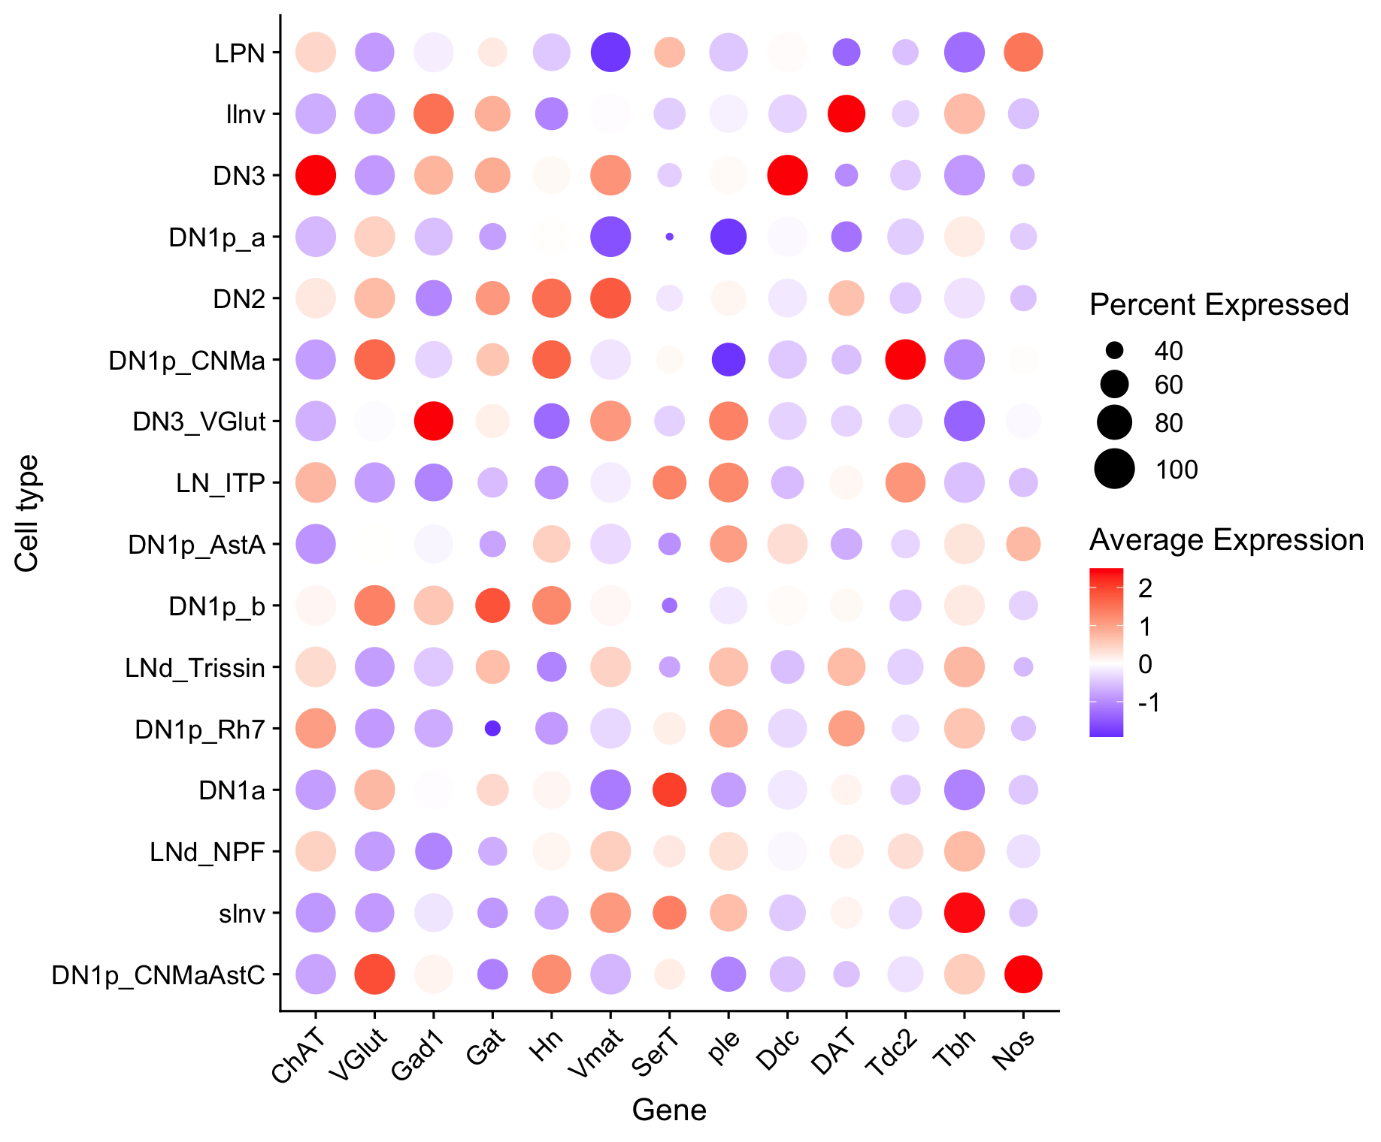
Non-scaled expression
"VAChT" "ChAT" "VGlut" "Gad1” “Gat” "Hn" "Vmat" "SerT" "Trhn" "ple" "Ddc" "DAT" "Tdc1" "Tdc2" "Tbh" "HisT" "Nos" "GlyT"

Slide 2
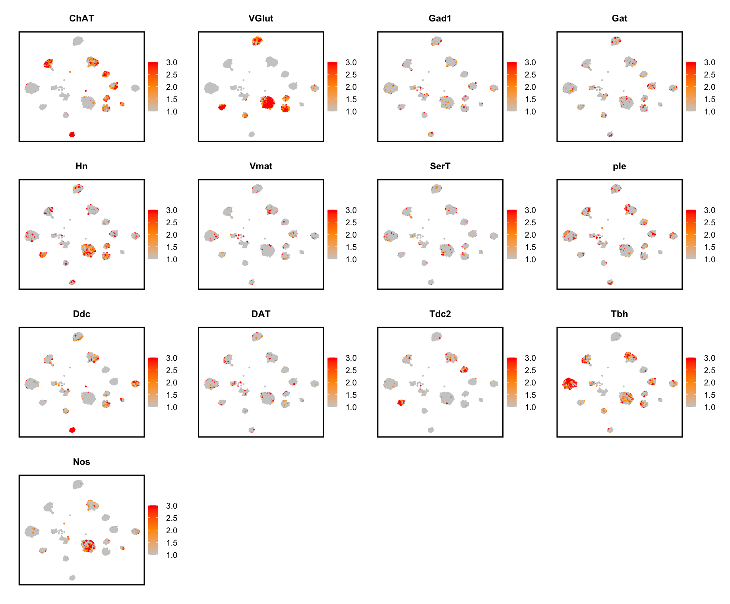
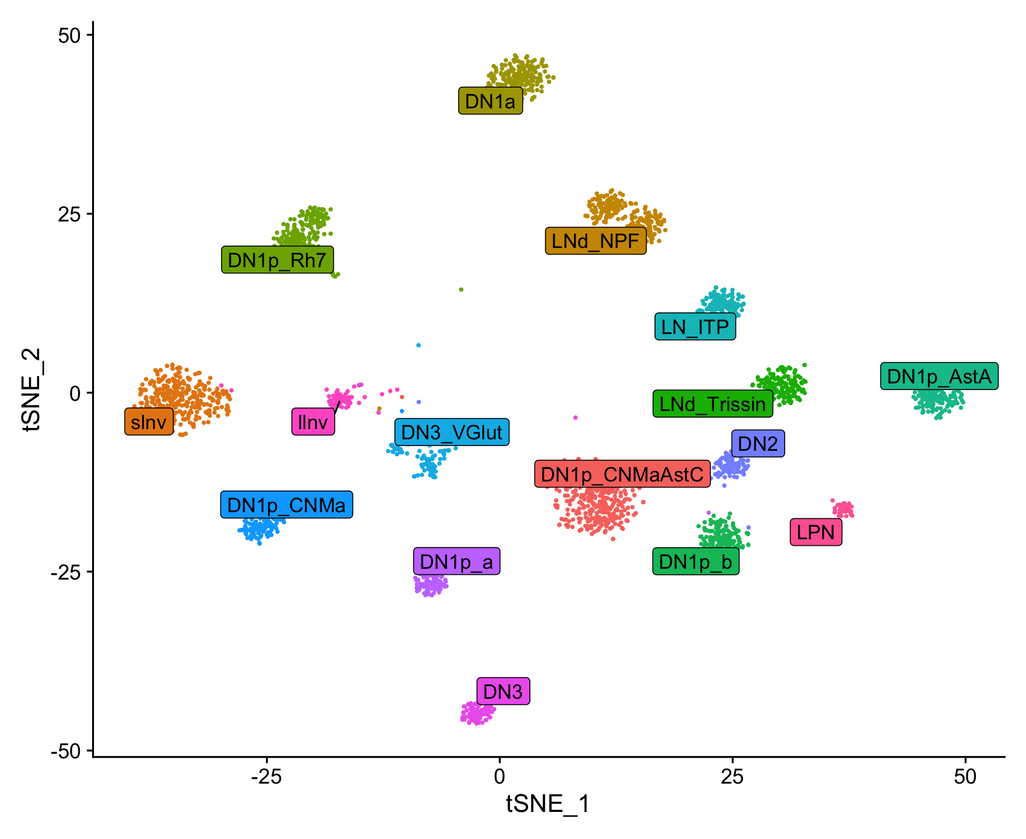
Scaled expression

